Slide 1
Introduction to Large Scale Databases

Slide 2
COURSE OUTCOMES
C331-3.1 | Infer the background processes involved in queries and transactions, and explain how these impact on database operation and design
C331-3.2 | Choose appropriate ways of storing data and optimize queries.
C331-3.3 | Explain the concept and challenge of big data and demonstrate the comparison of relational database systems with NoSQL databases
C331-3.4 | Compare and discover the suitability of appropriate large databases to manage, store, query, and analyze various form of big data
C331-3.5 | Apply techniques for data fragmentation, replication, and allocation to design a distributed or parallel database system

Slide 3
Module No. | Title of the Module | Topics in the Module
1. | Introduction to large scale Databases | Review of database systems, Data sources and join processing, modelling and query languages
2. | Transaction management | Transaction processing concepts, Concurrency control techniques and protocols
3. | Data Storage and Indexing | Data storage and indexing of massive databases in databases and data warehouses. Introduction to technologies for handling big data
4. | Query processing and Optimization | Measures of query cost, Evaluation of expressions, Query planning, evaluation and optimization
5. | Big data Tools and Technologies | Review of Big data, CAP Theorem (consistency, availability, partition tolerance), Using big data in businesses, Data visualization for data analysis, NoSQL databases
6. | Hadoop and its Ecosystem | Hadoop core components, Hadoop Ecosystem components, Data storage and processing in Hadoop framework
7. | Application-driven databases | Parallel and Distributed databases, Distributed Database Design, Architecture of Distributed DBMS
8. | Advanced databases | Graph databases, spatial and temporal databases

Slide 4
Name some database management systems
Name some database models

Slide 5
HISTORY REPEATS ITSELF
Old database issues are still relevant today.
The SQL vs. NoSQL debate is reminiscent of Relational vs. CODASYL debate from the 1970s.
Many of the ideas in today’s database systems are not new

Slide 6
1960s CODASYL
COBOL people got together and proposed a standard for how programs will access a database.
Lead by Charles Bachman.
→ Network data model.
Charles Bachmen’s Integrated Data Store (IDS) is said to be the first DBMS in history

Slide 7
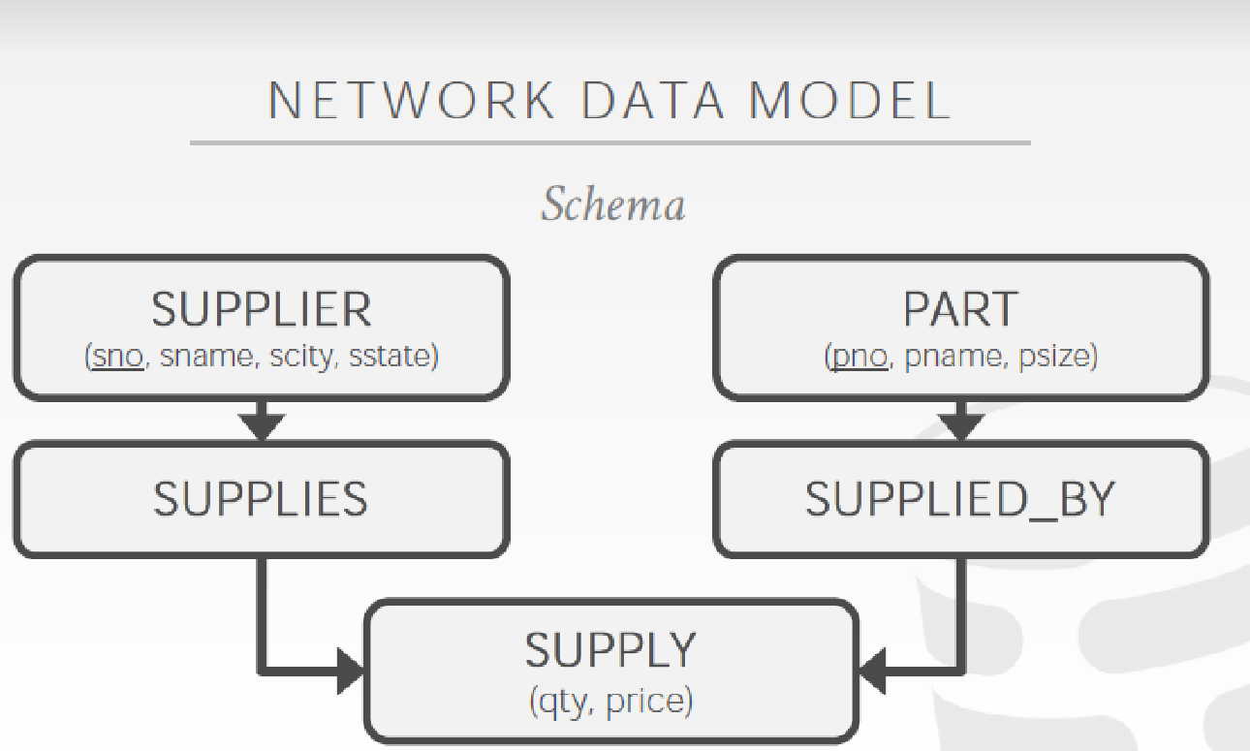
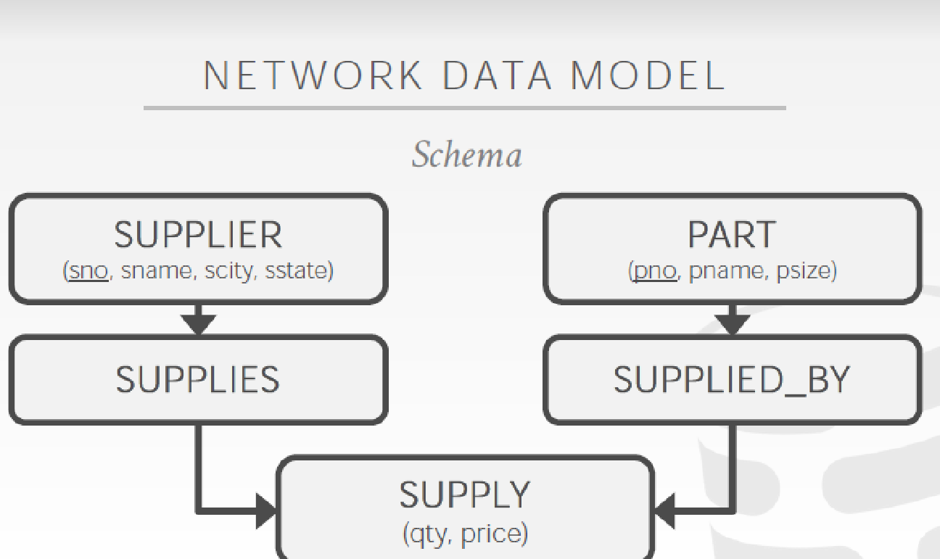

Slide 8
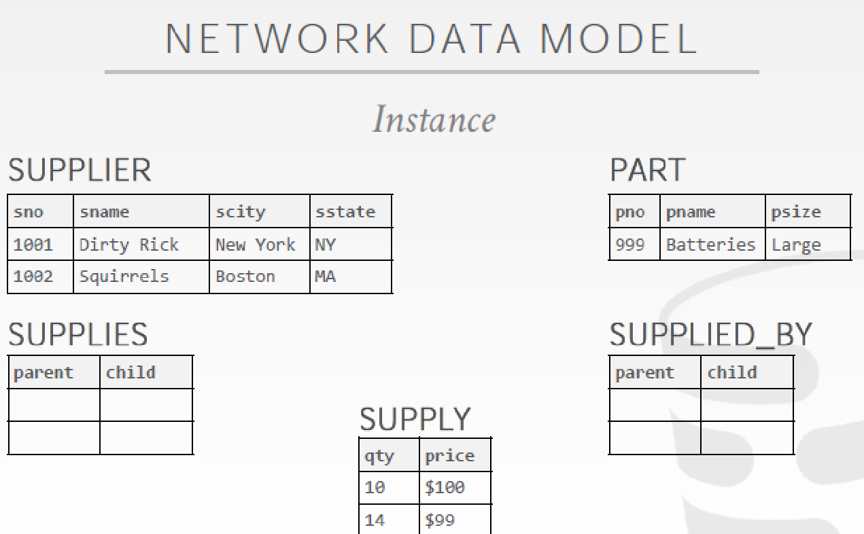

Slide 9
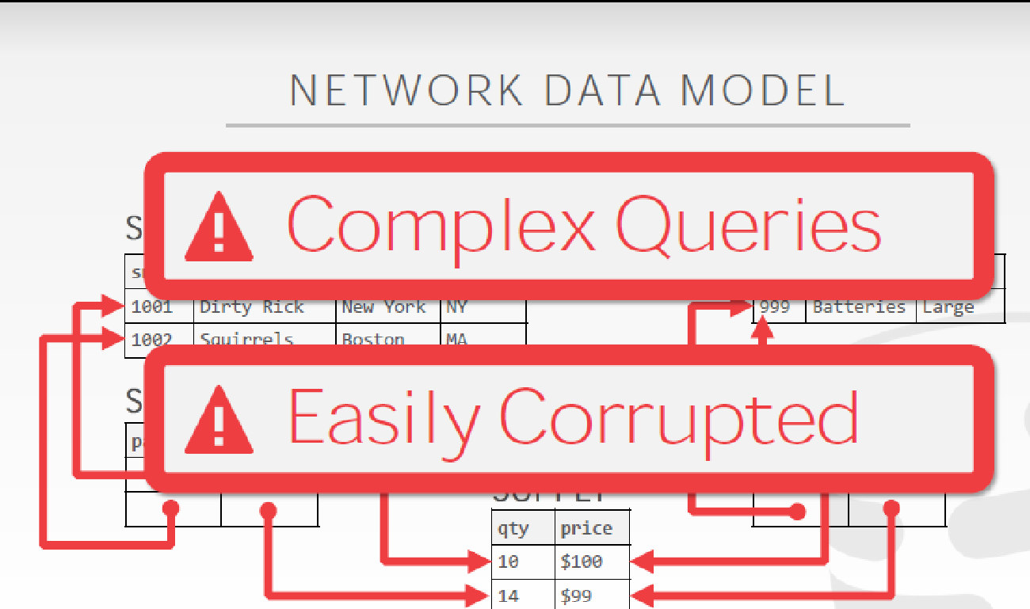

Slide 10
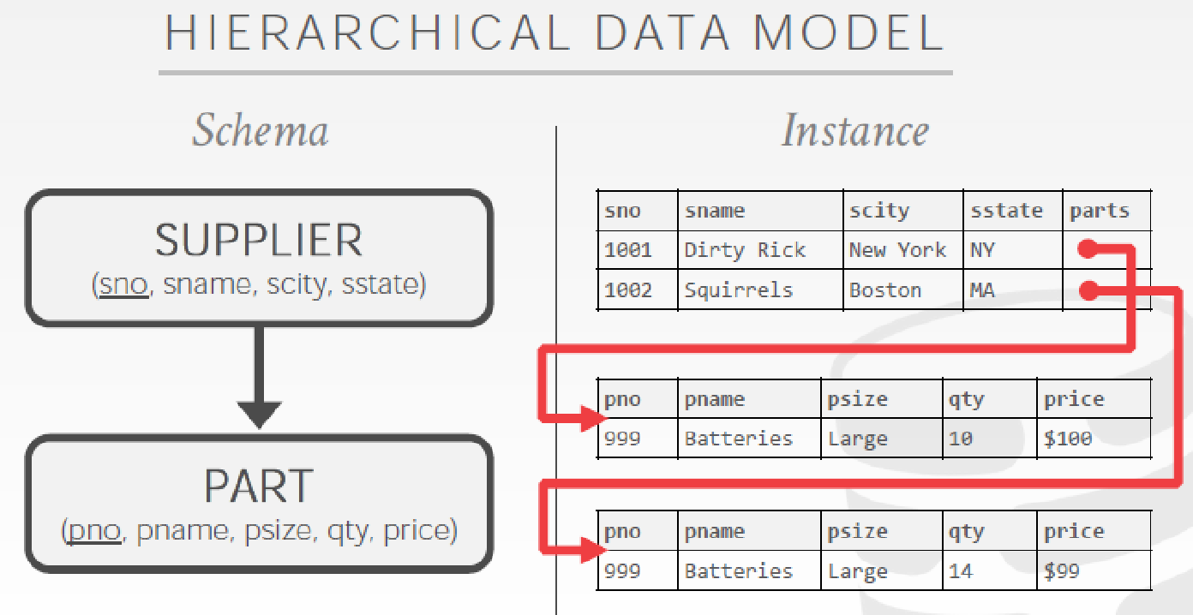

Slide 11
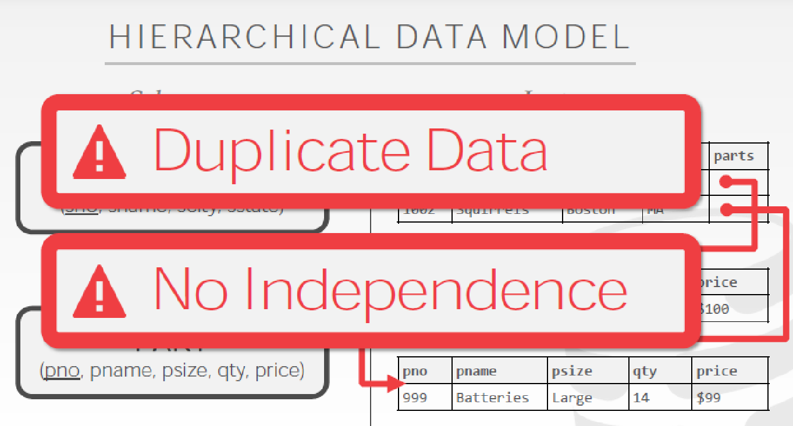

Slide 12
1970s RELATIONAL MODEL
Ted Codd was a mathematician working at IBM Research.
He saw developers spending their time rewriting IMS and Codasyl programs every time the database’s schema or layout changed.
Database abstraction to avoid this maintenance:
→Store database in simple data structures.
→Access data through high-level language.
→Physical storage left up to implementation.

Slide 13
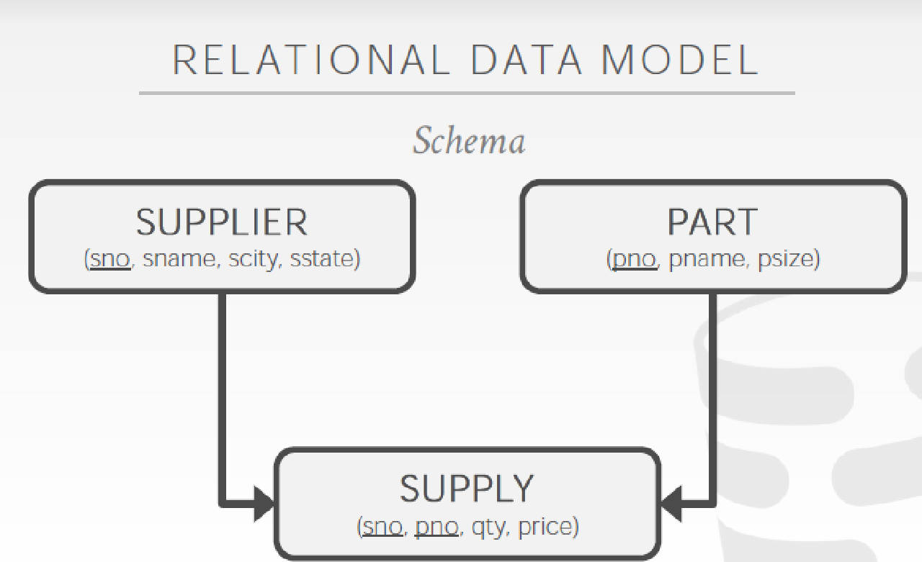

Slide 14
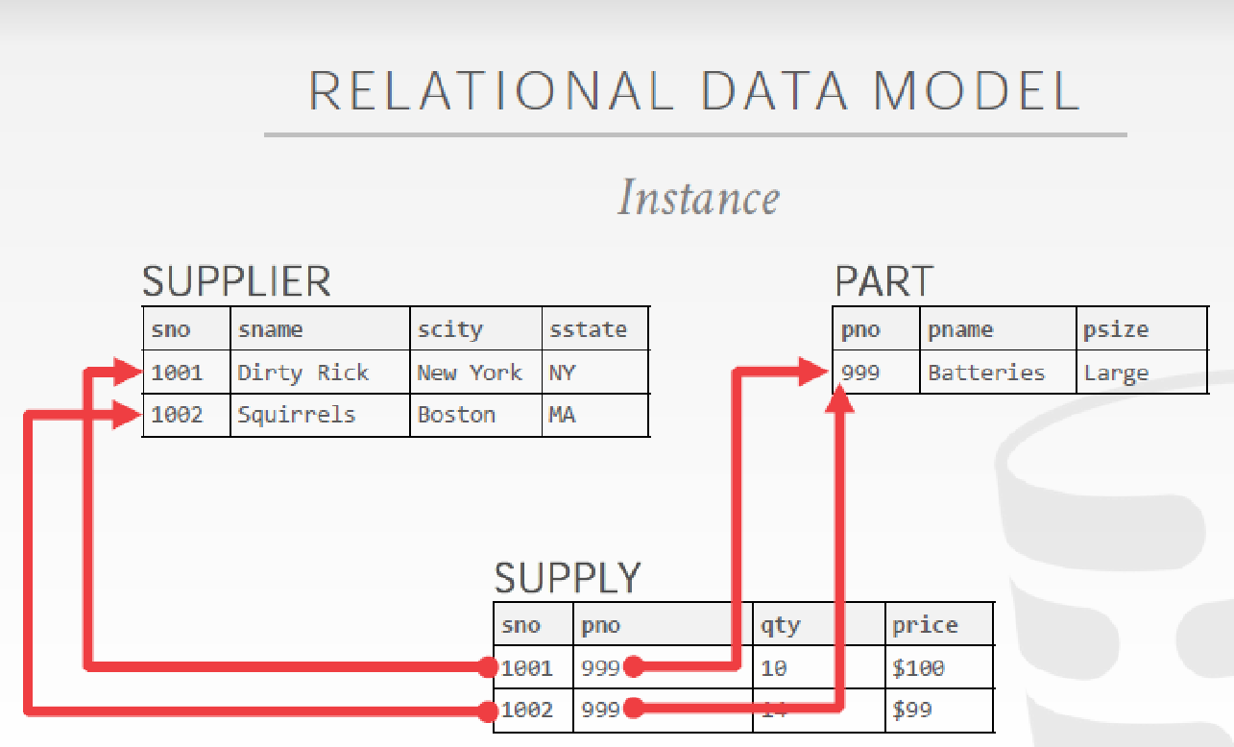

Slide 15
1970s RELATIONAL MODEL
Early implementations of relational DBMS:
→System R–IBM Research
→INGRES–U.C. Berkeley
→Oracle–Larry Ellison
→IBM comes out with DB2 in 1983.
→“SEQUEL” becomes the standard (SQL).
Many new “enterprise” DBMSs but Oracle wins marketplace.
Stonebraker creates Postgres.

Slide 16

1980s OBJECT-ORIENTED DATABASES
Avoid “relational-object impedance mismatch” by tightly coupling objects and database.
Few of these original DBMSs from the 1980s still exist today but many of the technologies exist in other forms (JSON, XML)

Slide 17
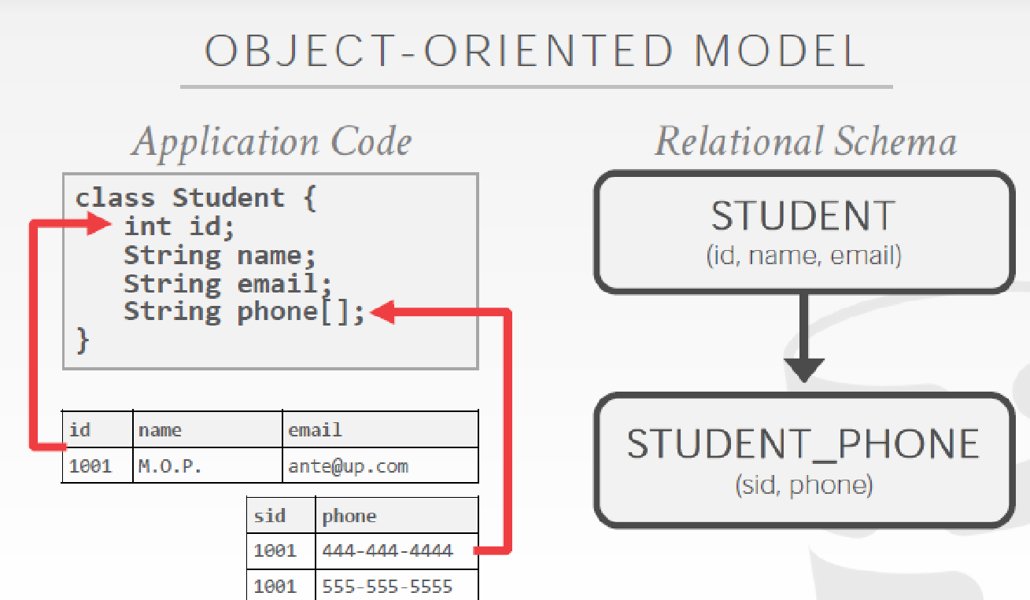

Slide 18
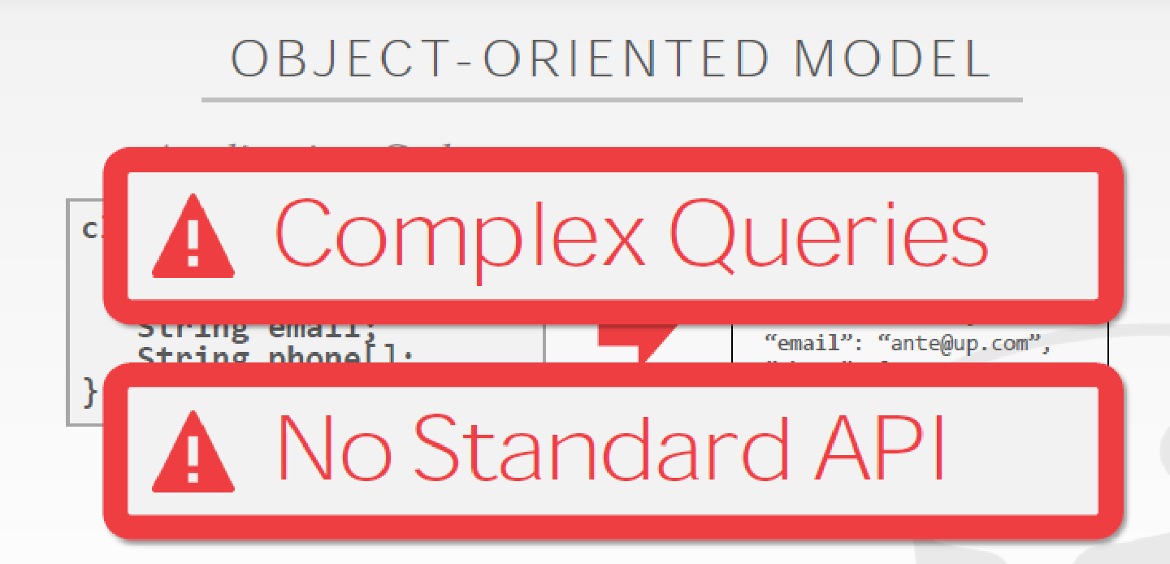

Slide 19
1990s
No major advancements in database systems or application workloads.
→Microsoft forks Sybase and creates SQL Server.
→MySQL is written as a replacement for mSQL.
→Postgres gets SQL support.
→SQLite started in early 2000.

Slide 20
2000s INTERNET BOOM
Many companies wrote their own custom middleware to scale out database across single-node DBMS instances.

Slide 21
Scaling
Client Site
Client Site
Client Site
Load Balancer (Proxy)
App Server
App Server
App Server
App Server
App Server
MySQL Master DB
MySQL Slave DB
Database becomes the Scalability Bottleneck
Cannot leverage elasticity
Replication

Slide 22
Scaling
Client Site
Client Site
Client Site
Load Balancer (Proxy)
App Server
App Server
App Server
App Server
App Server
MySQL Master DB
Replication
MySQL Slave DB

Slide 23



Scaling
Client Site
Client Site
Client Site
Load Balancer (Proxy)
Apache
+ App Server
Apache
+ App Server
Apache
+ App Server
Apache
+ App Server
Apache
+ App Server
Scalable and Elastic,
but limited consistency and operational flexibility
Key Value Stores

Slide 24

2000s DATA WAREHOUSES
Rise of the special purpose OLAP DBMSs.
→Distributed / Shared-Nothing
→Relational / SQL
→Usually closed-source.

Slide 25
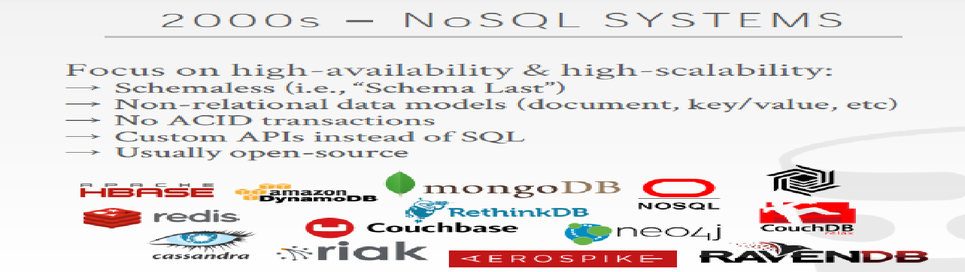
2000s NoSQL SYSTEMS
Focus on high-availability & high-scalability:
→ Schemaless (i.e., “Schema Last”)
→ Non-relational data models (document, key/value, etc)
→ No ACID transactions
→ Custom APIs instead of SQL
→ Usually open-source

Slide 26
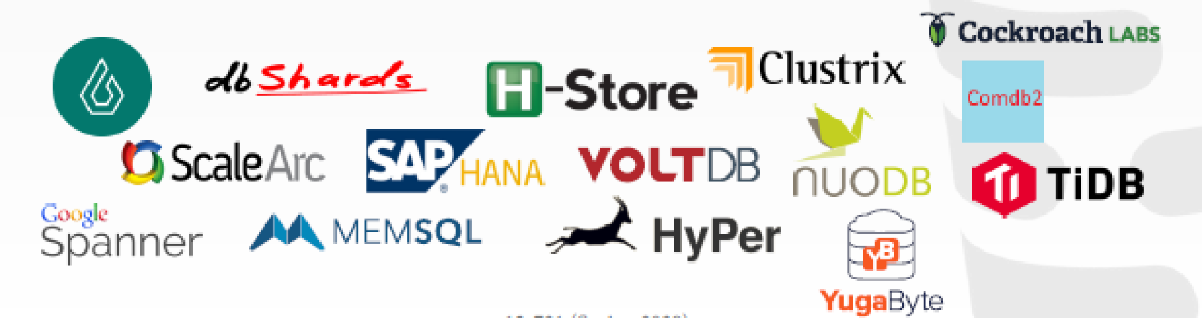
2010s NewSQL
Provide same performance for OLTP workloads as NoSQL DBMSs without giving up ACID:
→Relational / SQL
→Distributed
→Usually closed-source

Slide 27

2010s CLOUD SYSTEMS
First database-as-a-service (DBaaS) offerings were "containerized" versions of existing DBMSs.
There are new DBMSs that are designed from scratch explicitly for running in a cloud environment.

Slide 28

2010s SHARED-DISK ENGINES
Instead of writing a custom storage manager, the DBMS leverages distributed storage.
→Scale execution layer independently of storage.
This is what is referred to as a data lake.

Slide 29

2010s TIMESERIES SYSTEMS
Specialized systems that are designed to store timeseries / event data.
The design of these systems make deep assumptions about the distribution of data and workload query patterns.

Slide 30
2010s SPECIALIZED SYSTEMS
Embedded DBMSs
Multi-Model DBMSs
Blockchain DBMSs
Hardware Acceleration

Slide 31
Another way of Classification
In-memory database or on-disk database
In-memory is a data storage software that holds all of its data in the memory of the host.
The main difference between a traditional database and an in-memory database relies upon where the data is stored.
Even when compared with solid-state drives (SSD), random access memory (RAM) is orders of magnitude faster than disk access.
Examples?

Slide 32
Another way of Classification
Because an in-memory database uses the RAM for storage,
-> faster access to the data than with a traditional database using disk operations.
On the downside, they are at high risk of losing data in case of a server failure, since the data is not persisted anywhere.
If a server failure or shutdown should occur, everything currently in the memory of that computer would be lost due to the volatile nature of RAM.
The cost of memory is much higher than the cost of hard disks. This makes in-memory databases much more expensive.

Slide 33
Too many choices !
Think of a large e-commerce website.
The information about the products is crucial and should be kept on a persisted storage, but the information in the shopping cart could potentially be kept in an in-memory database for quicker access.
What about user names & passwords?

Slide 34
Large Scale or “Big Data”
‘Big-data’ is similar to ‘Small-data’, but bigger
Having data bigger consequently requires different approaches:
techniques, tools & architectures
...to solve:
New problems...
...and old problems in a better way

Slide 35
Big Data Sources
Big Data EveryWhere!
Lots of data is being collected and warehoused
Web data, e-commerce
purchases at department/grocery stores
Bank/Credit Card transactions
Social Network
Tweets stored in a flat file
A collection of image file in a directory
Historical weather observations that are stored as XML files.

Slide 36
Why is “big data” a “big deal”?
Private Sector
Walmart handles more than 1 million customer transactions every hour, which is imported into databases estimated to contain more than 2.5 petabytes of data
Facebook handles 40 billion photos from its user base.
Falcon Credit Card Fraud Detection System protects 2.1 billion active accounts world-wide
Science
Large Synoptic Survey Telescope will generate 140 Terabyte of data every 5 days.
Biomedical computation like decoding human Genome & personalized medicine
Social science revolution
-…

Slide 37
Volume of data
Bytes
KiloBytes 2¹⁰
MegaBytes 2²⁰
GigaBytes 2³⁰
TeraBytes 2⁴⁰
PetaBytes 2⁵⁰
ExaBytes… ZettaBytes…YottaBytes!!

Slide 38
1st Character of Big data Volume
Scientific and research experiments, such as the Large Hadron Collider (LHC) generates 15 PB a year
Sensors such as GPS sensors, RFIDs, smart meters
Social media such as Facebook and Twitter
Facebook has 2.5 PB of user data + 15 TB/day
Google processes 20 PB a day

Slide 39
Velocity of data
Velocity refers to the speed at which data is processed
Batch
Real Time
Streams

Slide 40
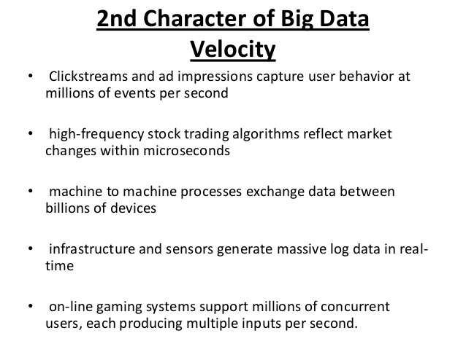

Slide 41
Variety
Variety includes different types of data
Structured
Unstructured
Semi structured
All of the above

Slide 42
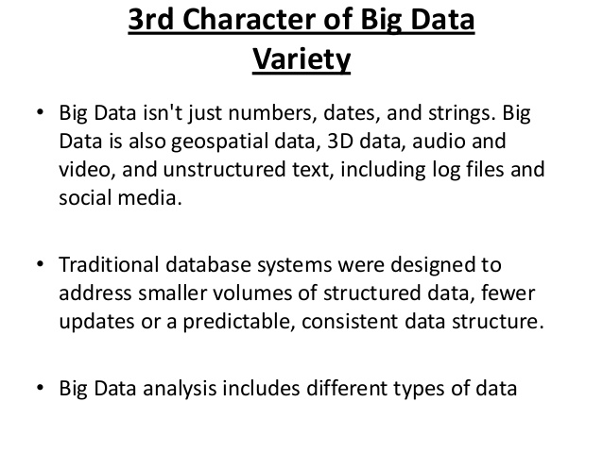

Slide 43
Veracity
Veracity is the quality or trustworthiness of the data. Just how accurate is all this data?
Data that is acquired in a controlled environment, for example via online customer registration, usually contain less noise than data acquired via uncontrolled sources such as blog postings.
Data that enters Big data environments needs to be assessed for quality, which can lead to data processing activities to resolve invalid data and remove noise.

Slide 44
What is “big data”?
"Big Data are high-volume, high-velocity, and/or high-variety information assets that require new forms of processing to enable enhanced decision making, insight discovery and process optimization” (Gartner 2012)
Complicated (intelligent) analysis of data may make a small data “appear” to be “big”
Bottom line: Any data that exceeds our current capability of processing can be regarded as “big”

Slide 45
The Power of Big data
Big Data can bring “big values ” to our life in almost every aspects.
Technologically, Big Data is bringing about changes in our lives because it allows diverse and heterogeneous data to be fully integrated and analyzed to help us make decisions
Today, with the Big Data technology, thousands of data from seemingly
unrelated areas can help support important decisions
This is the power of Big Data.
Areas of Applications
Health and Well being
Policy making and public opinions
Smart cities and more efficient society
New online educational models: MOOC and Student-Teacher modeling
Robotics and human-robot interaction
Much of this power hinges on Research on Analytics

Slide 46
Analysis of Large Scale data
Interdisciplinary endeavour that blends mathematics, statistics, computer science and subject matter expertise

Slide 47
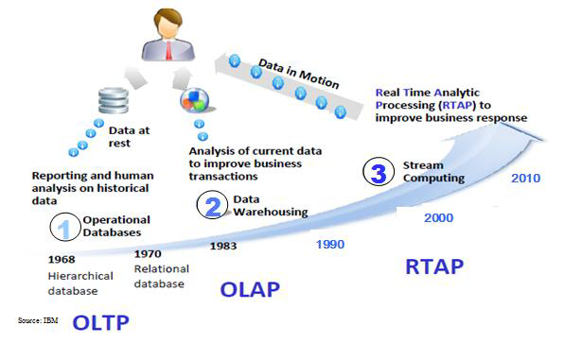
Harnessing Big Data: Analytics
OLTP: Online Transaction Processing (DBMSs)
OLAP: Online Analytical Processing (Data Warehousing)
RTAP: Real-Time Analytics Processing (Big Data Architecture & technology

Slide 48
Lifecycle of Data: 4 “A”s
Scattered
Data
Aggregation
Integrated
Data
Acquisition
Analysis
Log data
Knowledge
Application

Slide 49
What Technologies Do We Have To Tackle Big Data Challenges??

Slide 50
NOSQL
(NO SQL or NOT Only SQL)

Slide 51
Relational Databases Challenges
• Supporting large no of users on the web was different from supporting thousands of business users on a single database application.
Web application developers needed to support
Large volumes of read and write operations
Low latency response times
High availability

Slide 52
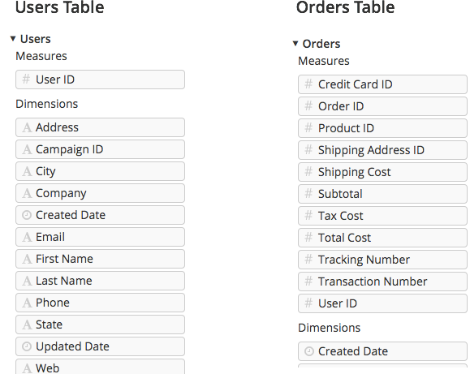
Example
You are an ecommerce site which maintains a record of customers and their orders

Slide 53
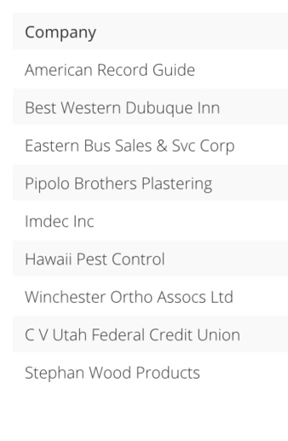

A sample dataset:
We need to answer the question - which customers have made the most purchases?

Slide 54
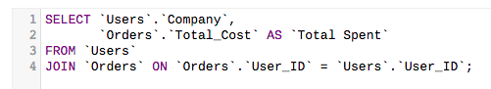
Is the above correct?
Each company has made several purchases, so there are many entries for each company. We want to sum and display the purchases made for each company.
Write the correct one

Slide 55
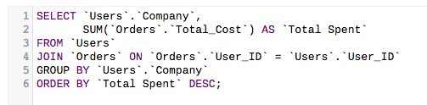

Slide 56
SQL: Imperative or Declarative?
How are joins implemented?

Slide 57
Implementing the JOIN Operation
R _{A=B} S
J1 Nested-loop join (brute force):
For each record t in R (outer loop), retrieve every record s from S (inner loop) and test whether the two records satisfy the join condition t[A] = s[B].
J2 Single-loop join (Using an access structure to retrieve the matching records):
If an index exists for one of the two join attributes — say, B of S — retrieve each record t in R, one at a time, and then use the access structure to retrieve directly all matching records s from S that satisfy s[B] = t[A].

Slide 58
Implementing the JOIN Operation
J3 Sort-merge join:
If the records of R and S are physically sorted (ordered) by value of the join attributes A and B, respectively, we can implement the join in the most efficient way possible.
Both files are scanned in order of the join attributes, matching the records that have the same values for A and B.
In this method, the records of each file are scanned only once each for matching with the other file—unless both A and B are non-key attributes, in which case the method needs to be modified slightly.

Slide 59
Implementing the JOIN Operation
J4 Hash-join:
The records of files R and S are both hashed to the same hash file, using the same hashing function on the join attributes A of R and B of S as hash keys.
A single pass through the file with fewer records (say, R) hashes its records to the hash file buckets.
A single pass through the other file (S) then hashes each of its records to the appropriate bucket, where the record is combined with all matching records from R.

Slide 60
Joins in Big Data?
Normalization?

Slide 61
Relational Databases Challenges
Some features of relational databases make them "challenging
•Fixed schemas –The schemas must be defined ahead of time, changes are difficult, and lots of real-world data is "messy".
Solution: Get rid of the schemas!
•Complicated queries –SQL is declarative and powerful but may be overkill.
Solution: Simple query mechanisms and do a lot of work in code.
•Transaction overhead –Not all data and query answers need to be perfect. "Close enough is sometimes good enough".
•Scalability –Relational databases may not scale sufficiently to handle high data and query loads or this scalability comes with a very high cost.

Slide 62
NoSQL
NoSQL databases are useful for several problems not well-suited for relational databases with some typical features:
•Variable data: semi-structured, evolving, or has no schema
•Massive data: terabytes or petabytes of data from new applications (web analysis, sensors, social graphs)
•Parallelism: large data requires architectures to handle massive parallelism, scalability, and reliability
•Simpler queries: may not need full SQL expressiveness
•Relaxed consistency: more tolerant of errors, delays, or inconsistent results ("eventual consistency")
•Easier/cheaper: less initial cost to get started.

Slide 63
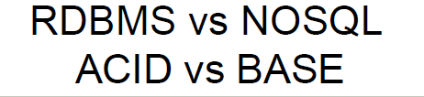
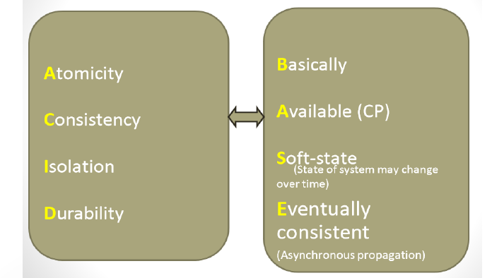

Slide 64
The BASE Properties
Databases with relaxed ACID guarantees apply the BASE properties:
Basically Available: the system guarantees Availability
Soft-State: the state of the system may change over time
Eventual Consistency: the system will eventually become consistent

Slide 65
Eventual Consistency
A database is termed as Eventually Consistent if:
All replicas will gradually become consistent in the absence of updates

Slide 66



Eventual Consistency
A database is termed as Eventually Consistent if:
All replicas will gradually become consistent in the absence of updates
Webpage-A
Webpage-A
Webpage-A
Webpage-A
Webpage-A
Webpage-A
Event: Update Webpage-A
Webpage-A
Webpage-A
Webpage-A
Webpage-A
Webpage-A
Webpage-A

Slide 67
Types of NoSQL Databases
Here is a limited taxonomy of NoSQL databases:
NoSQL Databases
Key-Value Stores
Columnar Databases
Document Stores
Graph Databases

Slide 68
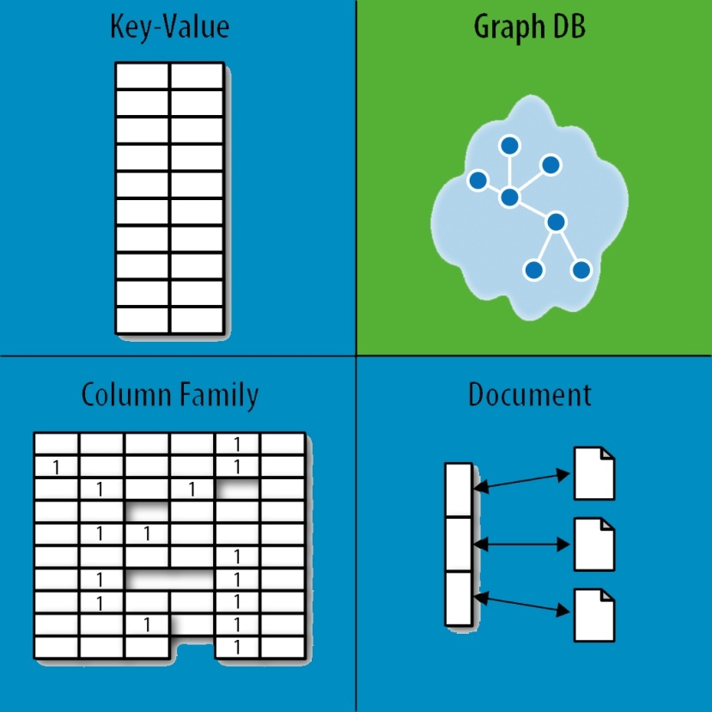
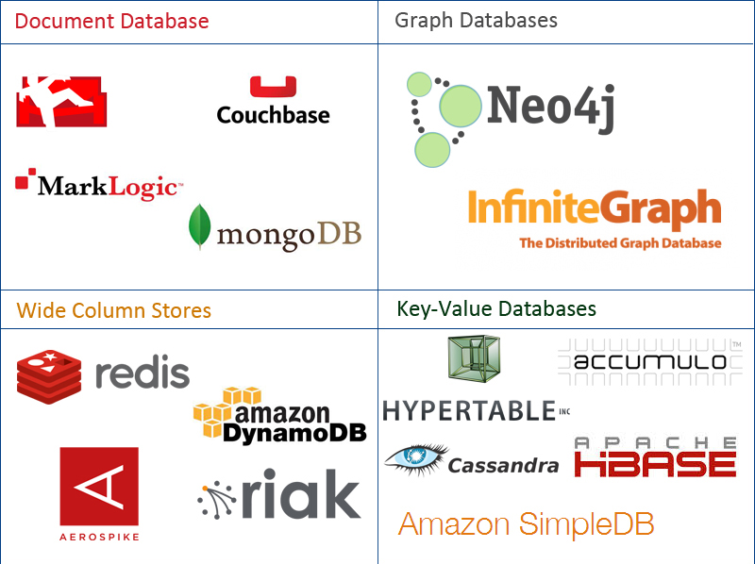
NoSQL Family

Slide 69
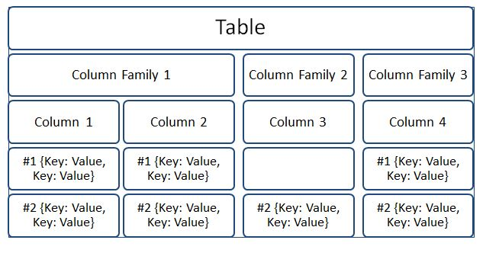
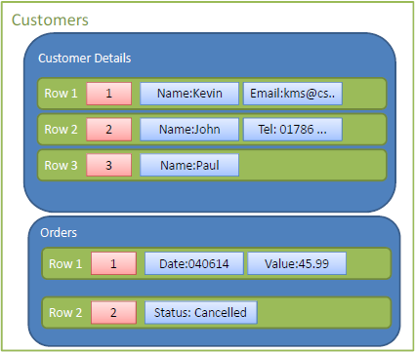
Column Family NoSQL
Storing health tracker data, Weather
service history. Internet of things status
and event history, personalization…

Slide 70
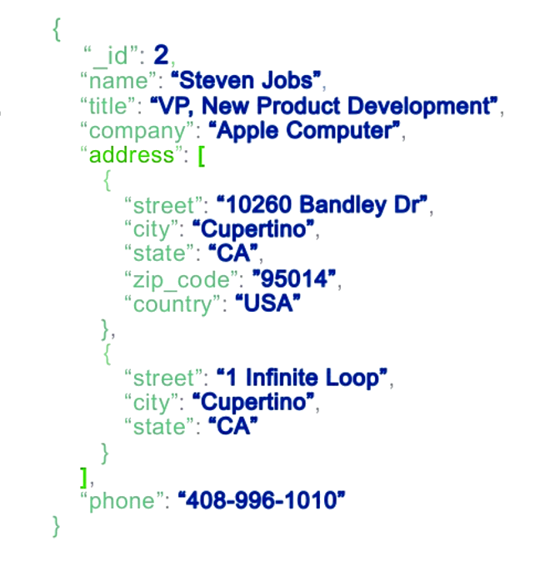
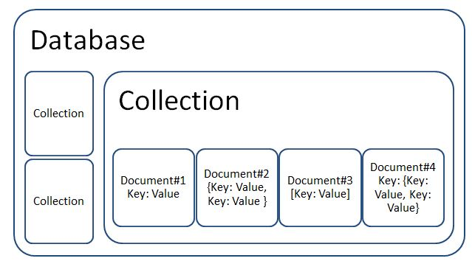
Document Oriented NoSQL
Catalog management, IoT data, Gaming,
Personalization, mobile apps…

Slide 71
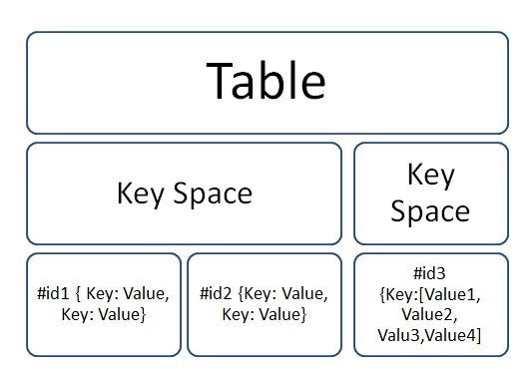
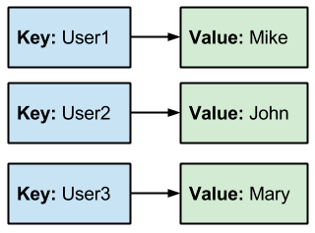
NoSQL Key Value Stores
Gaming Scoreboards, Session Caches, populating
timelines, feeds on SNs, Ecommerce, IP Address Tracking….

Slide 72
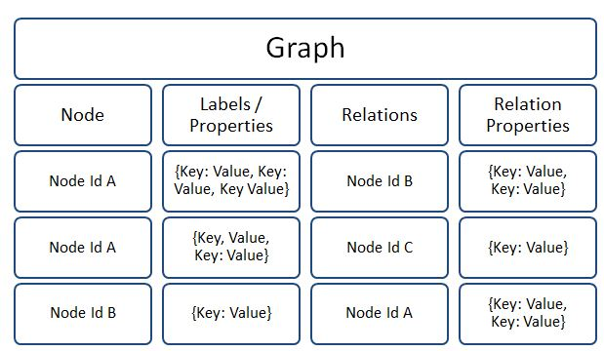
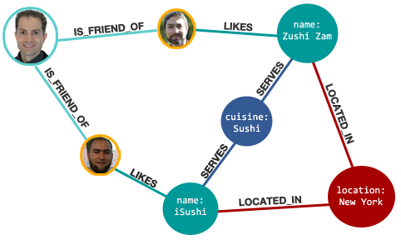
NoSQL Graph Databases
Recommendations, Fraud Detection, manage complex interdependencies in telecommunications, IT infrastructure, supply-chain management…..

Slide 73
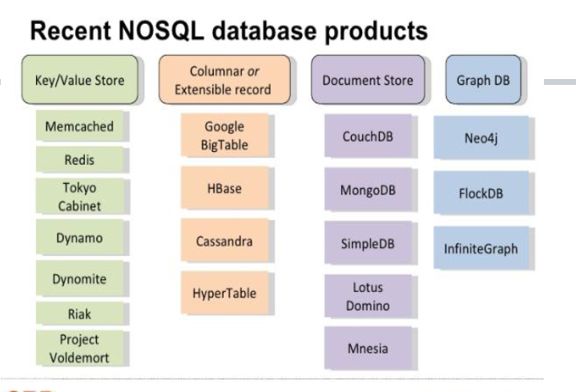

Slide 74
Example 1
For effective fraud detection and identity authentication, the data types analyzed extend far beyond transactional information.
They could include anything from demographic data, help desk information from the CRM system, website interactions, historical shopping data, and much, much more.
It would be impossible to develop a schema upfront that would define everything customers might want to do in the future.

Slide 75
Example 2
Providing a fast, personalized experience is no longer a differentiator.
Today, customers expect a consistent, high-quality, tailored experience from your brand, 24/7, across all devices.
They demand near real-time interactions and relevant recommendations.
If you don’t, you run the risk of them turning to Twitter or Facebook and amplifying your shortcomings.

Slide 76
Example 3
A defense and security application requires data integrity at all costs. Features of encryption, auditing, and alerting are also required.

